Slide 1

Line Coding & Decoding

Slide 2

Signal Levels (Elements) Vs Data Levels (Elements)

Slide 3
Pulse Rate Vs Bit Rate
Example
A signal has two data levels with a pulse duration of 1 ms. We calculate the pulse rate and bit rate as follows:
Pulse Rate = 1/ 10⁻³= 1000 pulses/s
Bit Rate = Pulse Rate x log₂ L = 1000 x log₂ 2 = 1000 bps

Slide 4
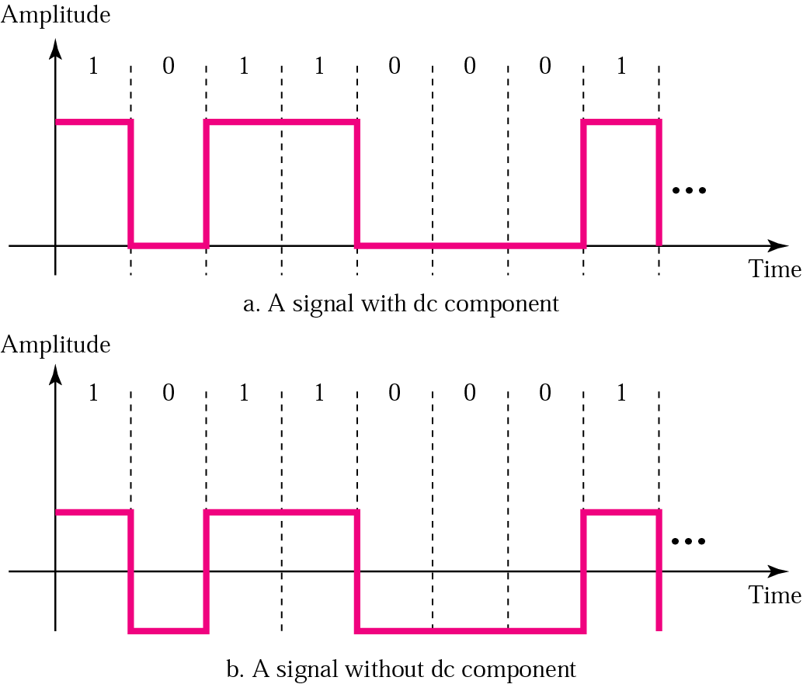
DC Component

Slide 5
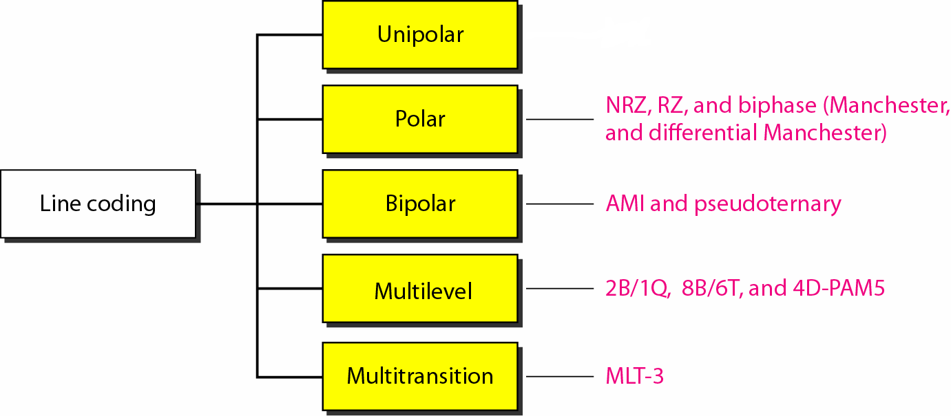
Line Coding Schemes

Slide 6

Note
In unipolar encoding, we use only one voltage level.

Slide 7
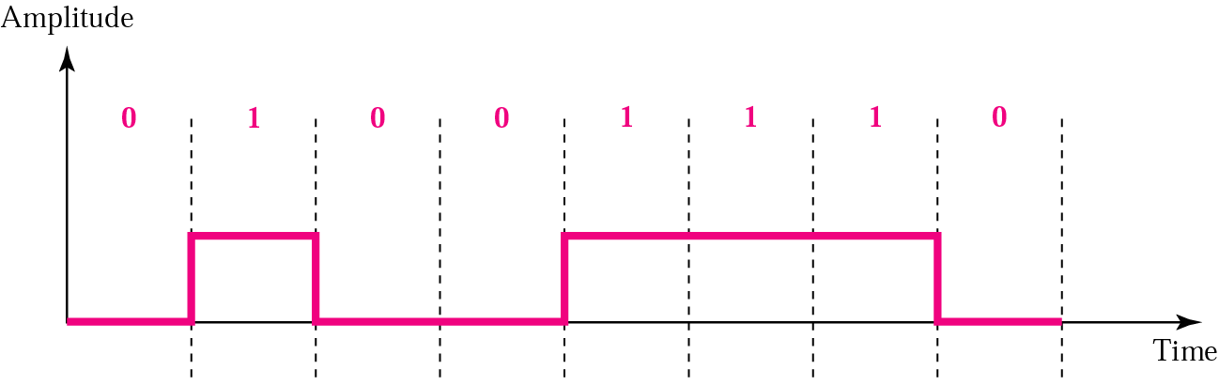
Unipolar Encoding

Slide 8
Note
In polar encoding, we use two voltage levels: positive & negative

Slide 9
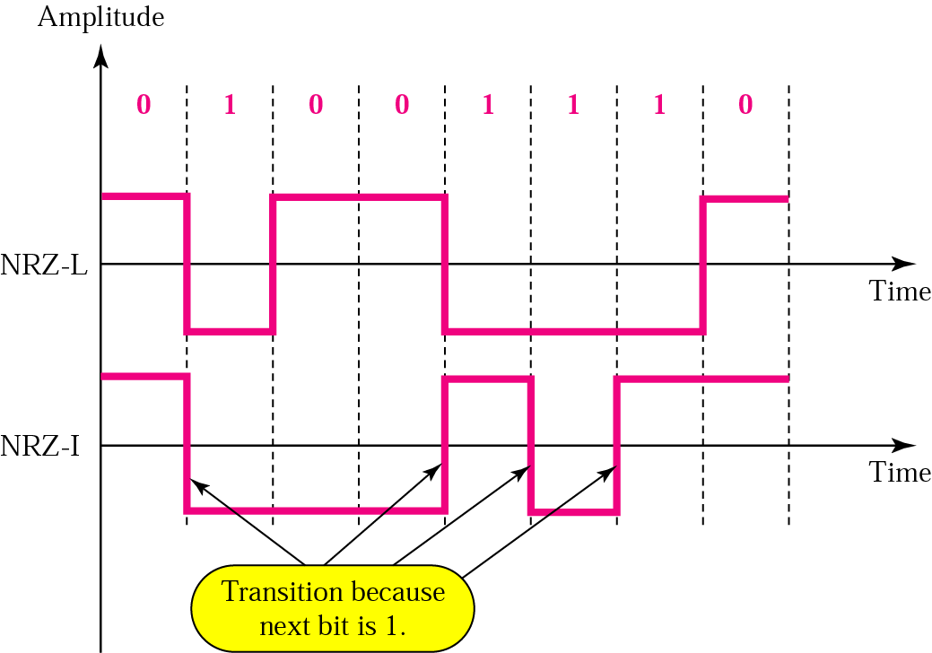
Polar: NRZ-L and NRZ-I Encoding

Slide 10
Note
In NRZ-L the level of the voltage determines the value of the bit.
In NRZ-I the inversion
or the lack of inversion
determines the value of the bit.

Slide 11
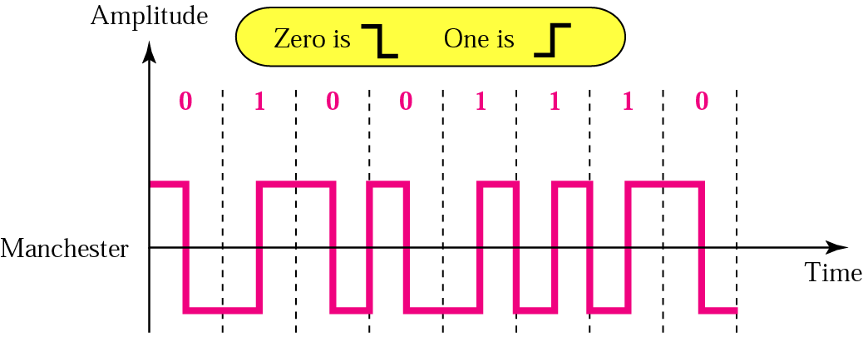
Polar: Manchester Encoding

Slide 12
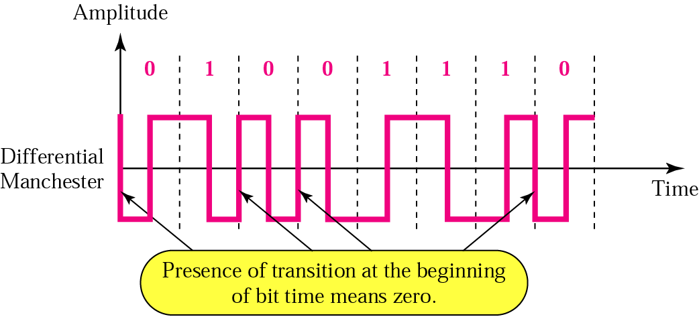
Polar: Differential Manchester Encoding

Slide 13
Note
In Manchester and differential Manchester encoding, the transition
at the middle of the bit is used for synchronization.

Slide 14
Note
In bipolar encoding, we use three levels: positive, zero, and negative.

Slide 15
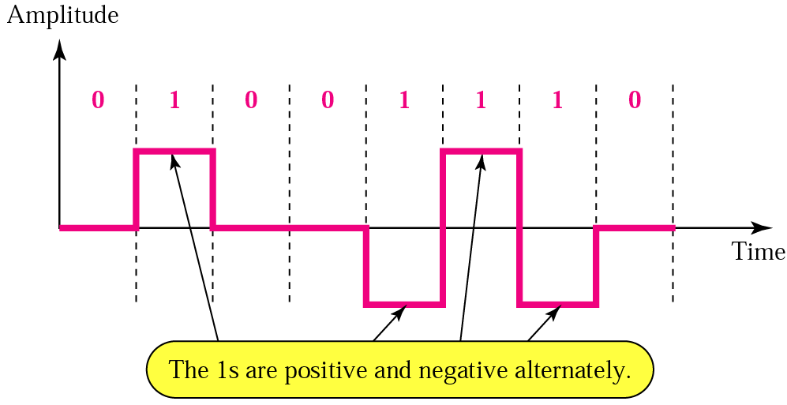
Bipolar: AMI (Alternative Mark Inversion) Encoding

Slide 16
Transmission Modes

Slide 17
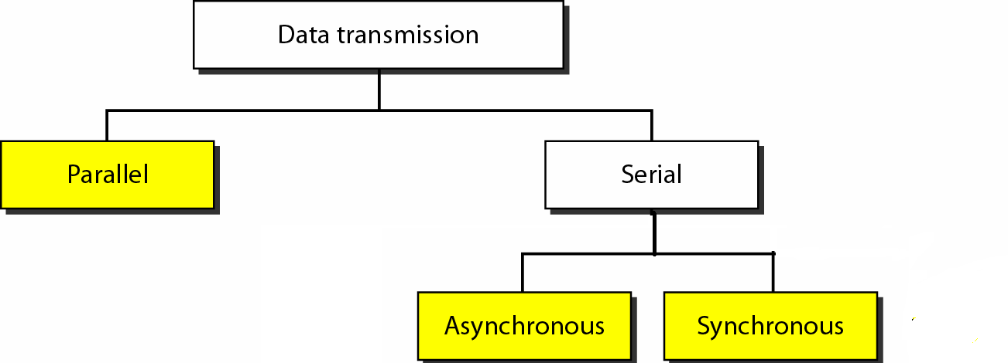

Slide 18
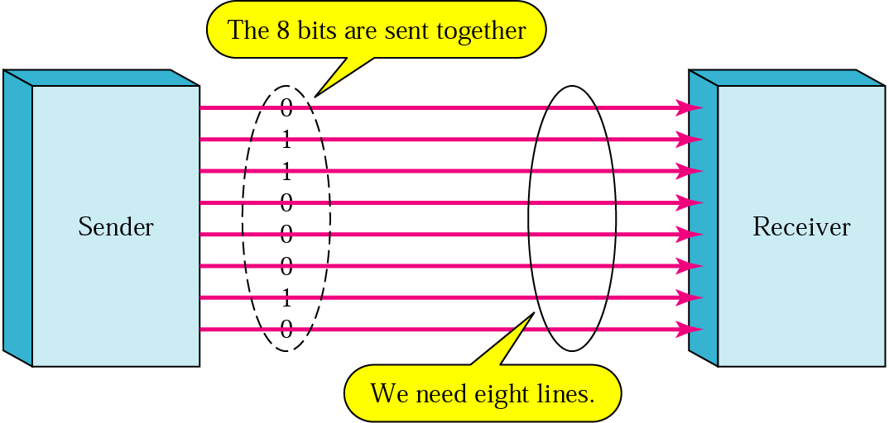
Parallel Transmission

Slide 19
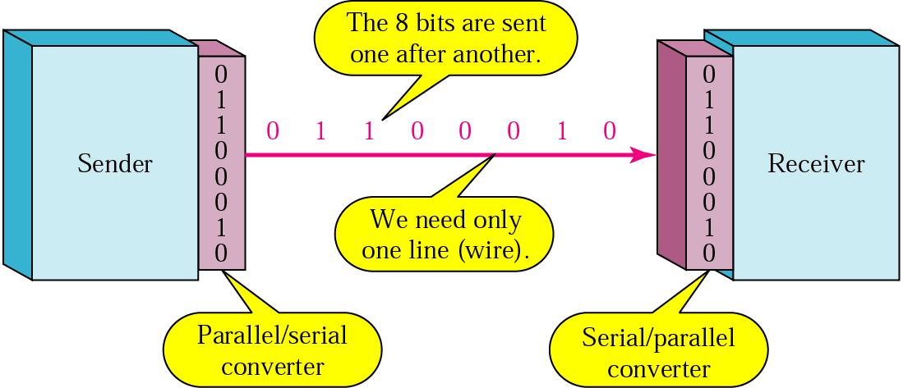
Serial Transmission

Slide 20
Note
In asynchronous transmission, we send 1 start bit (0) at the beginning and 1 or more stop bits (1s) at the end of each byte. There may be a gap between
each byte.

Slide 21
Note
Asynchronous here means “asynchronous at the byte level,”
but the bits are still synchronized;
their durations are the same.

Slide 22

Asynchronous Transmission

Slide 23
Note
In synchronous transmission, we send bits one after another without start or stop bits or gaps. It is the responsibility of the receiver to group the bits.

Slide 24
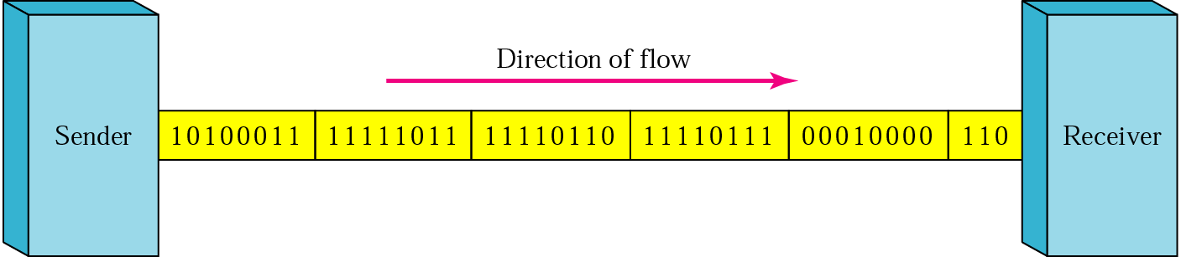
Synchronous Transmission

Slide 25
Readings
Chapter 4 (B.A Forouzan)
  Section 4.1, 4.2, 4.3

Slide 26


